Slide 1
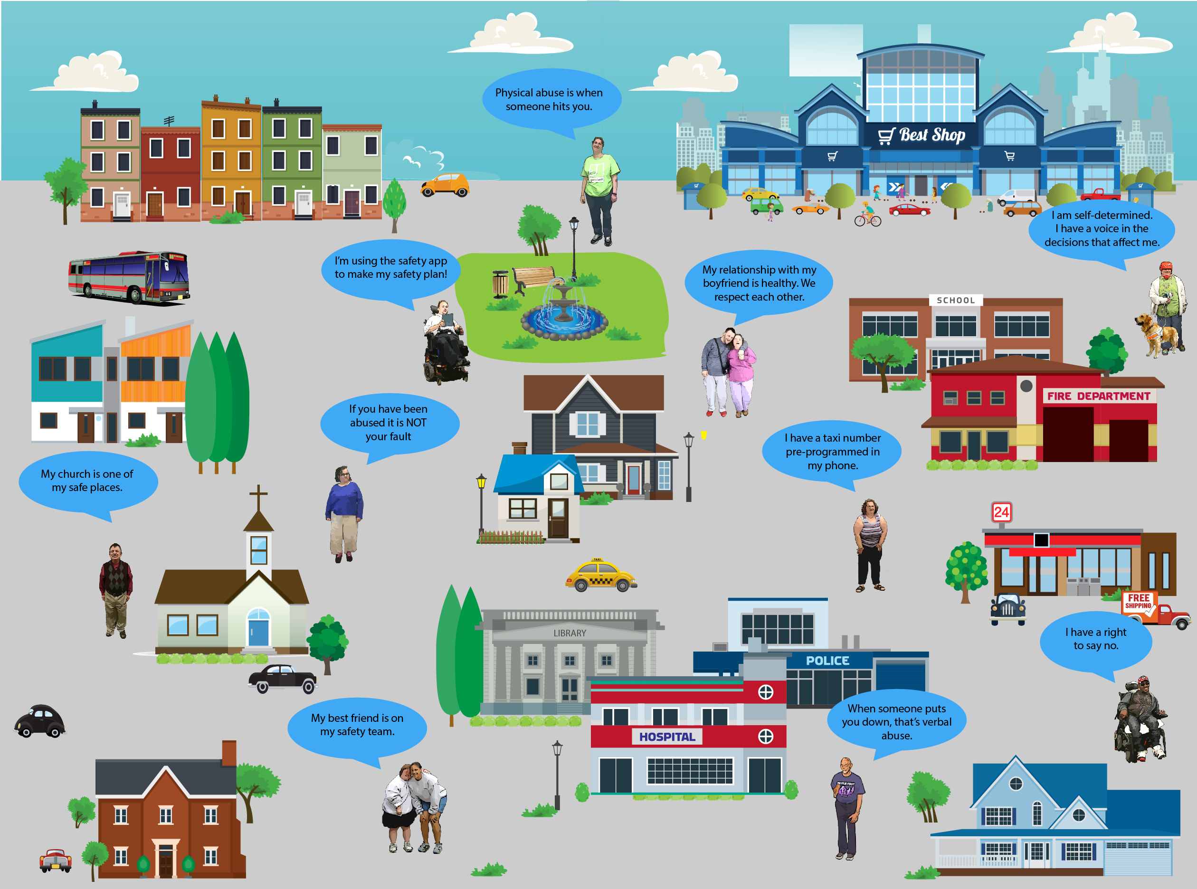
Keeping Safe: My Self-Determined Plan
Cindy Beckmann: beckmanncc@umkc.edu 816.235.1758
Ronda Jenson: jensonr@umkc.edu 816.235.6335
Know Abuse! No Abuse!
Using your computer, your iPad or other tablet to…
Learn how being self-determined can help you stay safe
Watch self-advocates tell their stories of being a survivor
Learn about healthy relationships (using the ESCAPE-DD curriculum)
Write your own safety plan (which will be loaded on your phone)
My Safety Plan helps me to…
Plan ahead for difficult situations.
Put together my Safety Team.
Know where the safe places are.
Load my cell phone with important numbers.
Lists what to do if someone hurts me.
Safety Planning
I feel safe when….. I feel unsafe when…. What kind of abuse am I worried about?
If anyone is hurting me, I can talk to…. If I need to leave my home to get away from someone hurting me, what do I need to take with me?
A joint project of The Missouri Division of Developmental Disabilities, The UMKC Institute for Human Development, The Kansas University Center on Developmental Disabilities (at the University of Kansas), private donors, and including content from the ESCAPE-DD Curriculum, An Effective Strategy-Based Curriculum for Abuse Prevention and Empowerment For Adults with Developmental Disabilities. Funded by the Joseph P. Kennedy, Jr. Foundation and the NY State Developmental Disabilities Planning Council.

